Slide 1
Specification test techniques
Prepared by: Jacek Okrojek
13 October 2015
Version: 1.0

Slide 2

Agenda
Black-box testing introduction
Domain testing techniques
Coverage in black box testing
PICT tool
Additional materials
Source code https://github.com/jacekokrojek/math.uni.lodz.pl
Notes:
Download source code for this lesson (lesson-2). If required install Gradle, Eclipse and Gradle plug in for Eclipse.

Slide 3
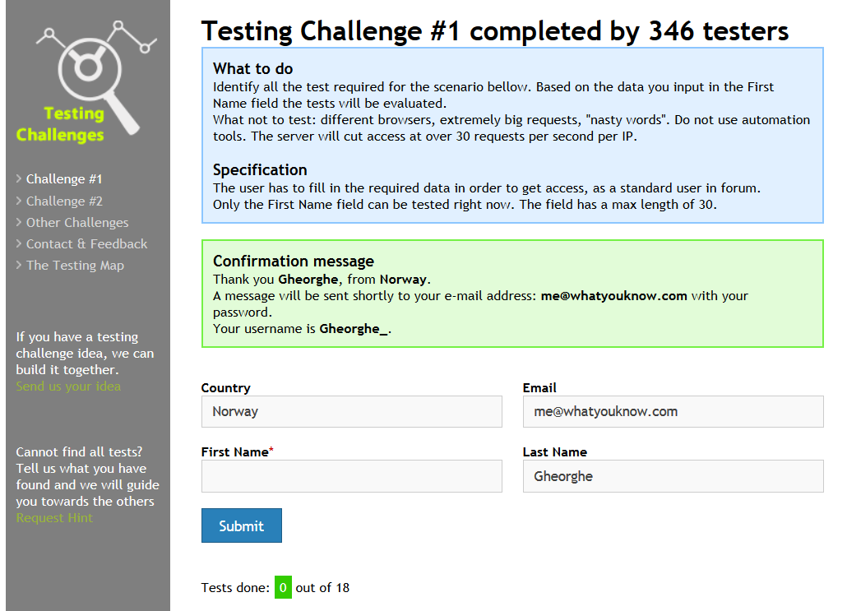
Testing techniques
Black Box or Specification based techniques
The tester designs tests from his (research-based) knowledge of the product's user characteristics and needs, the product's market, risks, and environment (hardware / software). Some authors narrow this concept to testing exclusively against an authoritative specification.
Domain testing is a set of Black Box techniques focus on
Input variable, including configuration and state variables
Output/results variables

Slide 4
Domain testing process
Characterize the variable
Identify potentially interesting variables
Identify primary dimension of the variable (type and scale)
Analyze variables and create tests
Partition the variable
Identify secondary dimension (danger cases)
Analyze function
Analyze relations between variables
Analyze output variables

Slide 5
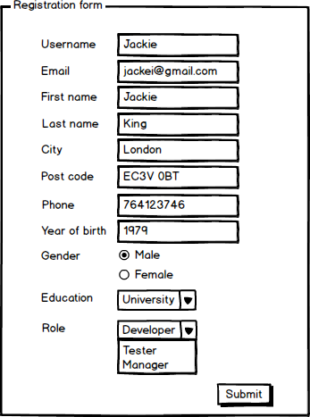
Characterize the variable
Identify potentially interesting variables.
Identify primary dimension of the variable (type and scale)
Consider input text box in registration form that allows for entering user's year of birth. It should store the number and this is its primary dimension. User however can insert letters or special characters. That not typical and potentially danger values a considered as secondary dimension of the variable.
Primary dimension can be typically one of:
Enumeration
Integer
Float
String
but it could also be
File

Slide 6
Analyze variables and create tests
In case of enumerations each possible value of the variable requires test case
Gender
Male
Female
Education
University
Primary School
Secondary School
Role
Tester
Manager
Developer
It is usually impossible to test all possible values for other variables types and we need some techniques that help us minimize number of tests.

Slide 7
Analyze variables and create tests
Equivalence partitioning (also called Equivalence Class Partitioning or ECP) is a software testing technique that divides the input data of a software unit into partitions of equivalent data from which test cases can be derived. In principle, test cases are designed to cover each partition at least once.
ECP technique is usually applied when values of the variable can not be ordered
Each equivalence class requires one test case
Post codes
N1C 4AA, K1C 4AB, W4C 4AD, V1C 4AE, NW7 1AB, EC2 1FD, ... | UK
00-982, 01-987, 05-300, 95-200, 90-890, ... | Poland
... | ...
Other | Invalid

Slide 8
Analyze variables and create tests
Boundary value analysis is a software testing technique in which tests are designed to include representatives of boundary values in a range. The idea comes from the boundary. Given that we have a set of test vectors to test the system, a topology can be defined on that set.
More powerful then ECP when values of the variable can be ordered.
For each boundary on and off value requires test case (Beizer, Black-Box Testing)
People under 18. can not register
0
17
18
User name may contain up to 20 characters (including).
0
20

Slide 9
Analyze variables and create tests
Boundary-Equivalence table is used to analyze to present cases that should be testes.
Below table presents analysis for username variable that should contain only [a-zA-ZółśćńźąężŁÓŚĆŃĄĘŻŹ] characters and not be longer then then 20 characters
Variable | Valid case EC | Invalid case EC | Boundry and special cases | Notes
Username | # characters 1-20 [a-zA-ZółśćńźąężŁÓŚĆŃĄĘŻŹ] |  | a
 |  |  | zAZZółśćńźąężŁÓŚĆŃĄ | To cover all chars except ĘŻŹ
 |  |  | aĘŻŹbBcCdDeEfFgGhHiI | To cover ĘŻŹ
 |  | # characters > 20 | ĘŻŹbBcCdDeEfFgGhHiIja
 |  | empty
 |  | ^[a-zA-ZółśćńźąężŁÓŚĆŃĄĘŻŹ] | @ | Before A in ASCII
 |  |  | [ | After Z in ASCII
 |  |  | ` | Before a in ASCII
 |  |  | { | After z in ASCII

Slide 10
Analyze variables and create tests
In many cases user can accidentally or not input value that he developer did not expect. In such case program should not crash or behave in danger way. Such values belongs to secondary dimension of the variable.
For each common variable type there are catalogs of such potentially danger variables that can help in test design.

Slide 11
Analyze variables and create tests
Additional cases should be also stored in Boundary-Equivalence table
Variable | Valid case EC | Invalid case EC | Boundary and special cases | Notes
Username |  | Regular expression | * | Regular expression
 |  |  | .+ | Regular expression
 |  |  | ?.+ | Regular expression
 |  | Non printable characters | \\n | Double escaped newline
 |  |  | \n | Single escaped newline
 |  | XSS | <script ... /> | Simplest XSS
 |  | SQL Injection | ' OR '1'='1 | Simplest SQL
 |  |  | space

Slide 12
Analyze function
All Singles is a approach to testing multiple variables together. It requires that each equivalence class/boundary for each variable should be tested at least once. It is not important in which case certain value is tested
Considering following parameters
P1: A1, B1, C1
P2: A2, B2, C2
P3: A4, B3, C3
we need 3 cases to satisfy this requirement
P1 | P2 | P3
C1 | C2 | B3
A1 | B2 | C3
B1 | A2 | A3

Slide 13
Analyze function
All Singles with base set guaranties similar coverage however assumes that some combination of values could be more valuable from the business perspective and should be tested
Considering following parameters
P1: A1, B1, C1
P2: A2, B2, C2
P3: A4, B3, C3
and
A1, A2, A3 are typically entered by user
we still need 3 cases to satisfy this requirement but it in cases
A1, A2, A3 and
A1, A2, B3 are typically entered by user
Additional case is required
P1 | P2 | P3
C1 | C2 | B3
A1 | A2 | A3
B1 | B2 | C3
P1 | P2 | P3
C1 | C2 | *
A1 | A2 | A3
A1 | A2 | B3
B1 | B2 | C3

Slide 14
Analyze function
All N-Tuples is an approach that requires to test each variable in combination with each other variable
Considering following parameters
P1: A1, B1, C1
P2: A2, B2, C2
P3: A4, B3, C3
we need 27 cases
P1 | P2 | P3
C1 | C2 | B3
A1 | C2 | C3
A1 | A2 | A3
B1 | A2 | C3
A1 | A2 | C3
A1 | A2 | B3
A1 | C2 | B3
C1 | C2 | A3
A1 | B2 | C3
C1 | B2 | A3
B1 | C2 | A3
C1 | B2 | C3
B1 | B2 | B3
A1 | B2 | A3
C1 | B2 | B3
C1 | C2 | C3
A1 | C2 | A3
C1 | A2 | A3
B1 | A2 | A3
B1 | B2 | C3
B1 | B2 | A3
C1 | A2 | B3
B1 | A2 | B3
A1 | B2 | B3
B1 | C2 | B3
B1 | C2 | C3
C1 | A2 | C3

Slide 15
Analyze function
All Pair is an approach that requires us to test all combination of pairs of variables.
It is based on the study showing that more then 90% of error in software are caused by of two or more parameters.
Considering following parameters
P1: A1, B1, C1
P2: A2, B2, C2
P3: A4, B3, C3
we need 10 cases
This approach can be extended to all triples etc.
PICT tool is very helpful when generation test cases using this approach
P1 | P2 | P3
C1 | A2 | A3
C1 | C2 | B3
A1 | C2 | C3
B1 | B2 | C3
C1 | B2 | B3
A1 | B2 | A3
C1 | A2 | C3
A1 | A2 | B3
B1 | C2 | A3
B1 | A2 | B3
Additional materials
PICT Tool - http://download.microsoft.com/download/f/5/5/f55484df-8494-48fa-8dbd-8c6f76cc014b/pict33.msi
PICT Tool information - https://msdn.microsoft.com/en-us/library/cc150619.aspx

Slide 16
Testing techniques
PICT tool requires us to write parameters and its possible values in the text file
By default All Pairs algorithm is used
User can specify other coverage conditions like All Singles, it could be done for all and also just some parameters
It is possible to specify which cases should be covered in tests generated by PICT and in that way provide base set of tests
#
# This is a sample model for testing All Pairs
#
P1: A1,B1,C1
P2: A2,B2,C2
P3: A3,B3,C3
#
# This is a sample model for testing All Triples
#
P1: A1,B1,C1
P2: A2,B2,C2
P3: A3,B3,C3
{ AP1, AP2 } @ 1
#
# This is a sample file with base values
#
P1 P2 P3
A1 A2 A3
A1 A2 B3

Slide 17
Analyze function
When submitting the button system process all input variables and presents results.
Output variables should be analyzed in the similar way to input variables and we should make sure all classes/boundaries are verified.
Considering registration form we could for example identify
Error messages
Invalid email
Invalid username
Etc
Success message
Storing information in database
Email with activation link sent

Slide 18
Error masking
In case when invalid values of different variables cause the same result (i.e. the same error message is displayed if user enters invalid username or first name) only one invalid value should be checked during the test.
Considering following parameters
P1: A1, B1, ~C1
P2: A2, B2, ~C2
P3: A4, B3, ~C3
We need 20 cases to satisfy All N-tuples assuming that incorrect parameters are not tested together.
AP1 | AP2 | AP3
A1 | A2 | B3
B1 | A2 | B3
B1 | A2 | A3
A1 | B2 | B3
B1 | B2 | A3
A1 | A2 | A3
B1 | B2 | B3
A1 | B2 | A3
A1 | ~C2 | A3
B1 | B2 | ~C3
~C1 | B2 | A3
~C1 | A2 | A3
A1 | A2 | ~C3
A1 | ~C2 | B3
A1 | B2 | ~C3
~C1 | A2 | B3
~C1 | B2 | B3
B1 | ~C2 | B3
B1 | A2 | ~C3
B1 | ~C2 | A3
public int foo(Object AP1, Object AP2, Object AP3)
throws ...{
if( AP1 == null)
throw new NullPointerException();
if( AP2 == null)
throw new NullPointerException();
if( AP3 == null)
throw new NullPointerException();
...
}

Slide 19
Task 2
Consider a situation where username, email and phone variables are submitted together
Create Boundary-Equivalence tables for email and phone number variables
Use https://en.wikipedia.org/wiki/Email_address as email address variable specification
Write Boundary-Equivalence tables in the README.md file.
Use sample file from lesson-3 directory
For Markdown help use https://help.github.com/articles/github-flavored-markdown/
Create input file for PICT containing username, email and phone variables
To start use sample file from lesson-3 directory
Store file created file in the lesson-3 directory
Use PICT to generate test cases using All Singles and All Pairs strategy
Write generated test cases to README.md file

Slide 20
Thank you!

